Slide 1
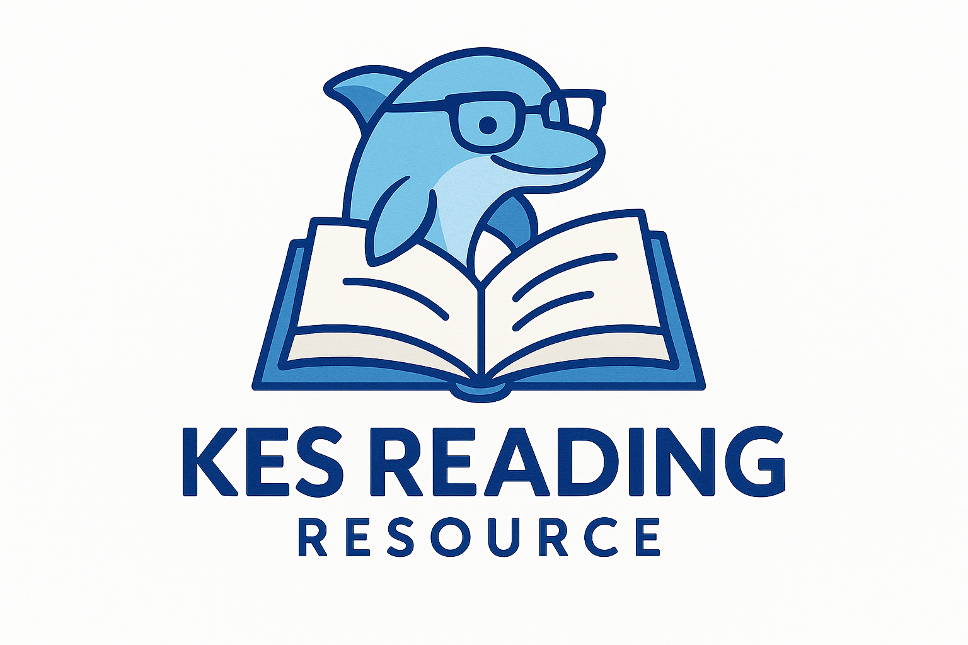
Helping Children Reach Their Full Potential
Reading is the gateway to all learning—and with the right support, every child can cross that gateway successfully.
Let us help your child discover the joy and confidence that come with becoming a strong reader.
Our Commitment to Families
At KES Reading Resource, you’re never navigating the reading journey alone.
We empower parents with the knowledge, direction, and resources needed to help their child grow into a confident reader.
Whether your child is struggling with decoding, fluency, comprehension, or foundational skills, we offer the clarity and next steps that lead to progress.
Why Choose KES Reading Resource?
✔ Personalized Reading Evaluations
We provide individualized, research‑based assessments that uncover specific reading gaps, skill deficits, and patterns of difficulty. Our evaluations give parents a clear, easy‑to-understand picture of their child’s current reading abilities.
✔ Actionable Insights for Families
Understanding the data is only the first step. We translate results into practical, parent‑friendly explanations so families know precisely what skills need strengthening and where support is most needed.
✔ Guidance Toward Effective Resources
We don’t just identify challenges—we help families overcome them. Parents receive targeted recommendations for evidence-based tools, strategies, and interventions that can help close learning gaps and build reading success.
Supporting Families. Strengthening Skills. Unlocking Readers.
At KES Reading Resource, we believe every child deserves the chance to become a confident, capable reader. For private and homeschooling families seeking clarity, guidance, and expert support, we offer comprehensive reading evaluations designed to illuminate exactly where a child may be struggling—and why!
Follow the link below to complete a request form for screening evaluation. Once submitted,
Our KES Reading Resource Team will be in touch with you shortly
Request Form
Click Here

